Slide 1
GEOINT
Bruce Carlson
17 October 2011

Slide 2
Notes:
UNCLASSIFIED
UNCLASSIFIED
Huge success: six satellites in seven months
Most aggressive launch schedule in 25 years and the satellites we launched are more complex and technically demanding than any we have launched before
True testament to the pioneering and innovative efforts of the men and women of the NRO
Refreshed the Nation’s overhead reconnaissance constellation – Average age down 2 years
Despite age of some satellites, still very robust, adaptable
Some, designed to monitor Soviet communication in Northern Fleet are now used to geo-locate sensitive signals in the war zone
Through this campaign and the dedicated efforts of the NRO workforce, we proved once again that the NRO knows how to develop, acquire, launch, and operate our nation’s intelligence collection satellite constellation.
This campaign was also the centerpiece of the NRO’s 50th Anniversary activities

Slide 3
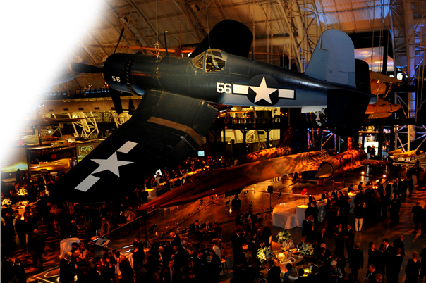
50th Anniversary Gala – Udvar Hazy
Notes:
Over the last 50 years and from reconnaissance planes to reconnaissance satellites, the NRO’s systems have been and continue to be the foundation for global situational awareness in protection of our Nation
The NRO has also transitioned from a mission focused on the Soviet Union to a diverse and widely dispersed mission that now includes international terrorists, drug traffickers, assessing the impact of natural disasters, and humanitarian relief operations.
So we certainly have a lot to celebrate. Last month, nearly 4,000 people attended the premier event of our commemorative activities – the 50th Gala at the Smithsonian’s Udvar-Hazy Center
It truly was a special evening and fitting tribute to the men and women of the NRO
We also announced the declassification of the GAMBIT and HEXAGON imagery satellite reconnaissance programs

Slide 4
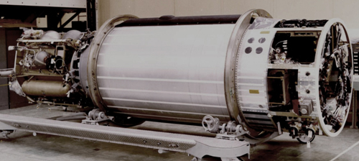
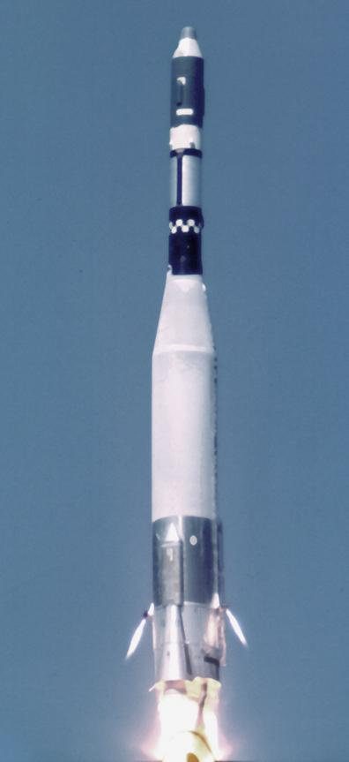
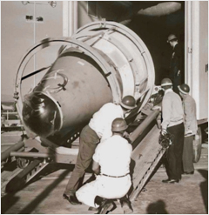
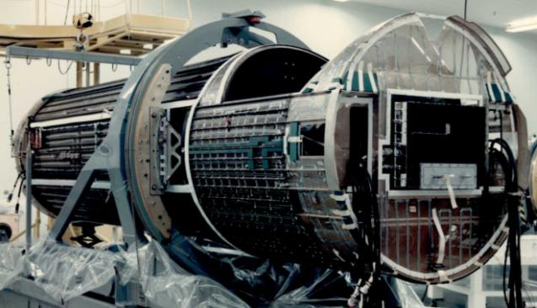
GAMBIT
Notes:
With its first Imagery Reconnaissance Satellite CORONA and it’s 40-foot resolution, the United States was able to determine the pace and scope of the Soviet Union’s ballistic missile deployments and analysts were able to count Soviet heavy bombers – however better resolution was required for more detailed analysis
In response GAMBIT 1 with the KH-7 camera system that included a 77-inch focal length camera was launched in July 1963 and operated until June 1967
GAMBIT I had thin film which permitted longer missions than CORONA and its roll capability and stereo cameras enabled increased target acquisition and gave images a three-dimensional quality
GAMBIT I had a resolution of 4 feet, monitored key targets and provided key cartographic information that allowed DoD to produce accurate, large-scale maps
The follow-on system, GAMBIT 3 operated from July 1966 to April 1984 and it had a KH-8 camera system and an 175-inch camera which provide resolution that was better than 2 feet

Slide 5
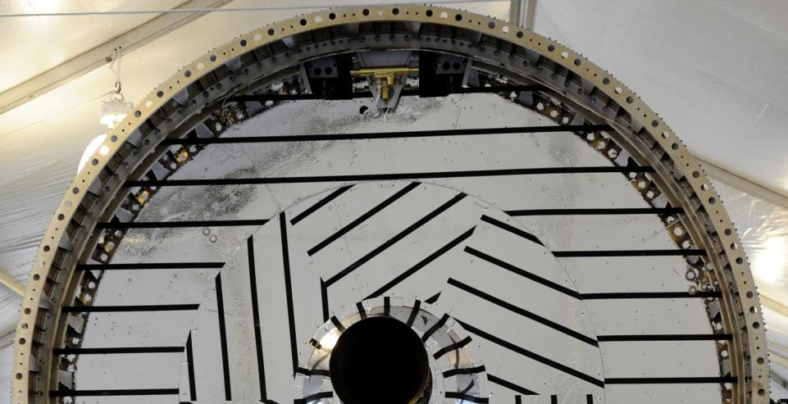
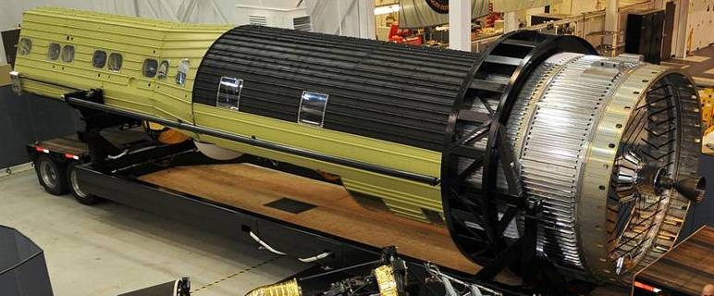
HEXAGON
Notes:
While GAMBIT’s imagery was very detailed, it could be compared to looking at a map through a soda straw. To work in concert with GAMBIT, HEXAGON was developed to provide a broad-area search and mapping capability – it operated from June 1971 to April 1986
HEXAGON had multiple film recovery buckets and extended missions which lasted an average of approximately four-months – improvements which moved the United States closer to achieving a continuous space imaging capability
One HEXAGON frame covered a distance of more than 400 miles or about the distance from San Antonio to a point between St Charles and Baton Rouge, Louisiana
HEXAGON carried 60 miles worth of film, which was nearly 300 times the amount carried on GAMBIT
Working together, GAMBIT and HEXAGON were America’s Eyes in Space and were the most sophisticated satellites of their time
But these systems were built with 1950s and 1960s technology -- the systems we put into orbit today are even more advanced

Slide 6
2012 Launch Campaign – Stay Focused
2012
MAR
APR
MAY
JUN
JUL
NROL-25
VAFB
Mar 2012
NROL-38
CCAFS
Jun 2012
NROL-15
CCAFS
Jun 2012
NROL-36
VAFB
Jul 2012
Without launch success, there can be no mission success!
Notes:
UNCLASSIFIED
UNCLASSIFIED
Compared to last year’s launch campaign, 2012’s campaign may look easy, but a lot of hard work and focus will be required from the men and women of the NRO to ensure we’re as successful with these four launches as we were with the past six
Especially when a Delta IV Heavy is on the schedule
The launch of these systems will not only improve on the NRO’s capabilities, they will also help reduce the overall age of our Constellation
Another area the NRO will continue to pay particular attention to in the year ahead is acquisition

Slide 7
Assessing Acquisition Strategies
NRO acquisition approach used for decades
Steady recurring investment to stabilize production rates
Quantity buys for improved efficiency
Steady non-recurring investment for manageable risk
De-coupled non-recurring from recurring investment
Acquisition Study looking at three strategies:
Buy on Need
Constellation Buy
NRO’s Proven Acquisition Approach
Notes:
At the NRO, we believe acquisitions should balance the desire for new technologies with the need to maintain current capabilities – and this approach has been very successful
The NRO uses steady recurring investment to stabilize production rates – the Industrial Base Heartbeat
This also allows us to take full advantage of Advanced Systems & Technology successes as soon as they deliver
Some can be incorporated in a proven vehicle design
Others will drive a new, revolutionary path
Its been so successful that our approach has drawn interest from OSD and we’ve agreed to a joint study to assess this strategy against others over a 30-year period

Slide 8
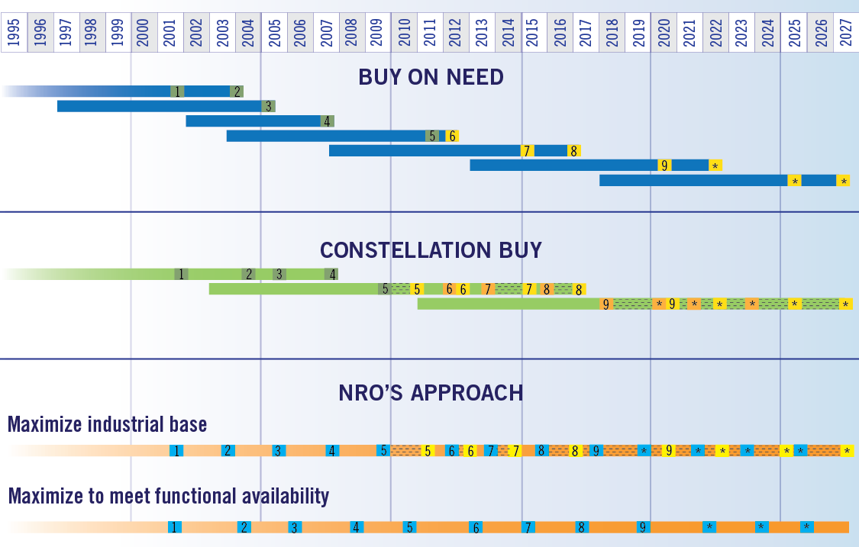
(U) Comparing Acquisition Strategies “A 30 Year Look”
Notes:
The alternative strategies are:
Buy to Need - incremental procurements based on expected satellite life
Best enhancements/technology insertion
Constellation Buy – block-buy based on expected constellation life
Includes coupled evolved enhancements/upgrades
Vehicles delivered ahead of need are stored
NRO’s Approach – fixed schedule buy, balancing industrial base and mission need
Procure to a pre-determined, steady production schedule
Enhancements/upgrades are decoupled from procurements – inserted when mature/developed (after risk buy down)

Slide 9
Assessing Acquisition Strategies
Relative Ranking/Score
Relative measures of merit assessed for each strategy | Buy on Need | Constellation Buy | NRO Approach
Predicted cost/schedule performance
Delivered capability | TBD | TBD | TBD
Ability to address evolving requirements
Industrial base impact
Budget stability
Functional availability | TBD | TBD | TBD
Magnitude of uncertainty/risk
Ranking/Score Legend
1 (highest)
2 (middle)
3 (lowest)
Notes:
We are developing a model applicable to multiple scenarios and concepts using data derived from NRO experiences with each acquisition strategy
However, early “30 year study” results validate past NRO successes
Lower cost and risk, with increased certainty of acquisition success
Now that I’ve caught you up on the NRO’s recent activities, I’d like to focus on the conference’s theme, “Forging Integrated Intelligence.”
The NRO has several integrated intelligence programs in operation or in development and I’d like to highlight a few

Slide 10
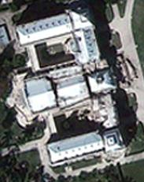
Joint Collaboration Cells
Lower quality information w/ high tactical value satisfies actionable time frame
Time vs. Tactical Value & Quality
Combat
Zone
Comfort
Zone
Value & Quality
Time
Haiti, Presidential Palace
Deep Water Horizon
Source: U.S.Coast Guard
Source: GeoEye
Notes:
The DNI envisions “a globally networked and integrated intelligence enterprise” and established guidance to certify Collaboration Nodes to help accomplish this vision
The NRO works with multiple agencies to operate three certified Joint Collaboration Cells at Aerospace Data Facilities-Colorado, East and Southwest
The primary goal of Joint Collaboration Operations is to put relevant intelligence into the hands of those who need it most, the Intelligence Community and the warfighter, when they need it most, 24/7/365
Today, 95% of the NRO’s GEOINT products and 90% of our SIGINT products are classified SECRET collateral, but less than 5% of our Soldiers have direct access to those products
These collaboration cells have proven to be invaluable:
Within minutes of a downed helicopter in Afghanistan, the JCC provided situational awareness data to the bandwidth constrained soldiers and it was used for a successful recovery mission
The NRO’s JCC’s have also been able to enhance commercial imagery products for disaster support to include during the oil spill in the Gulf and Haiti’s earthquake
Another important part of an integrated intelligence enterprise is providing multi-intelligence products

Slide 11
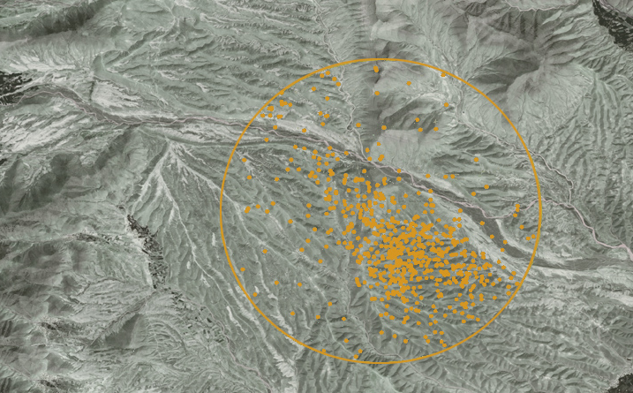
Fusion Analysis & Development Effort (FADE)
Multi-Intelligence Spatial Temporal Toolsuite (MIST)
Communication Externals of Ground moving target Indications to Human Intelligence
DigitalGlobe
Temporally and geospatially render millions of Data Elements
Notes:
Fusion is the core of the FADE Mission. Operational since 2007, FADE is focused on developing new tools and methodologies for visualizing large volumes of data in time and space to detect changes – which characterize “patterns of life”
These patterns of life can then be used for a variety of purposes to include mission planning and battlefield forensics
One of the primary tools used by FADE is the Multi-Intelligence Spatial Temporal Toolsuite or MIST
About five years ago, an analyst was quickly flipping through a series of Powerpoint slides that contained data from multiple sources, over several days and within a specific area of interest. He discovered that when the data set was in motion he was able to detect unusual communication patterns
MIST automates this entire process and readily displays it. These products are then made available to warfighters and others
FADE is used by the Intelligence Community, Department of Defense, and the Department of Homeland Security as an integral part of intelligence cells

Slide 12
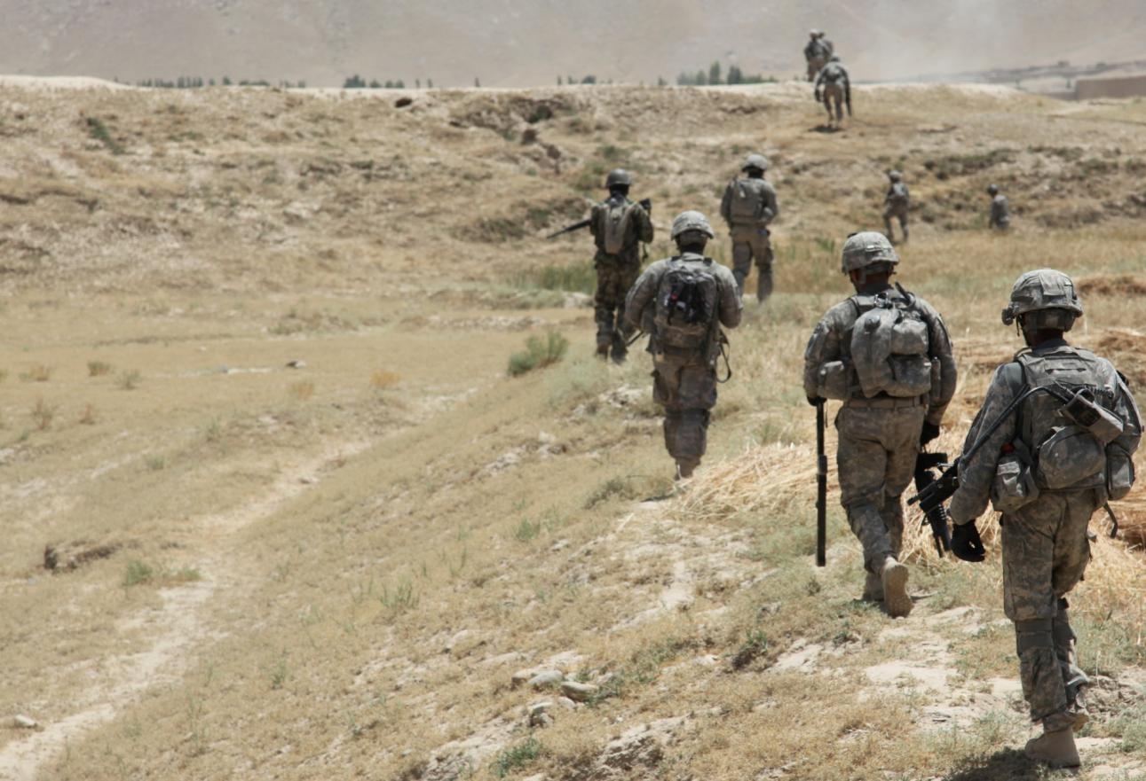
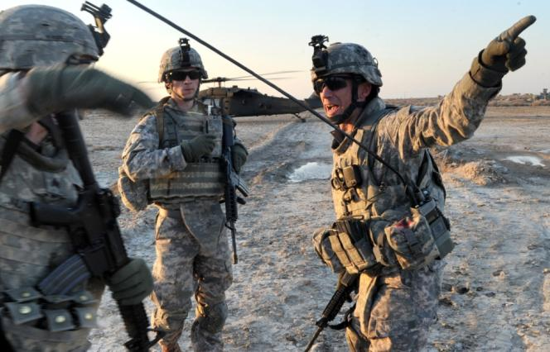
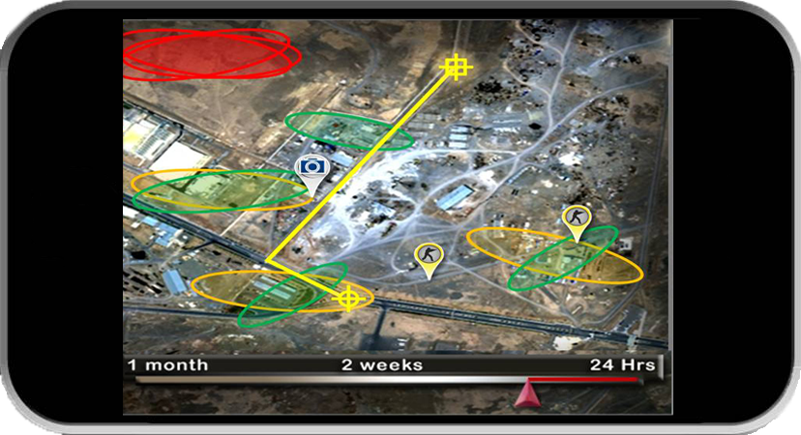
Advanced Multi-Intelligence Integration Tool
Notes:
In response to multiple Combatant Command intelligence requirements, the NRO is developing a new fusion product named the Advanced, Multi-Intelligence Integration Tool (AMIT)
AMIT will allow users the ability to quickly integrate, evaluate and interpret enhanced information in order to better understand the operational environment in a tactically relevant format and timeframe
In coordination with DIA, NGA and NSA, AMIT will use Open Source Intelligence, Geospatial Intelligence, Signals Intelligence and other metadata sources
AMIT will move the metadata across multiple security domains and then normalize it so it is searchable
Moving the metadata across security domains will significantly improve Multi-Intelligence access and situational awareness for disadvantaged users
AMIT is scheduled for an operational readiness demonstration in February 2012, followed by deployment to analysts in July. The eventual goal is to use AMIT for quick situational awareness for forces in the field.
In order to continue to develop products and services to be more collaborative and in order to respond to a rapidly evolving and increasingly difficult target environment and more sophisticated adversaries, the NRO is also re-shaping its future mission architecture

Slide 13
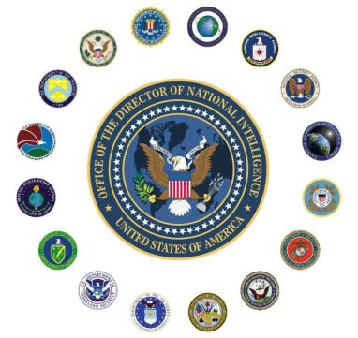
NRO Mission Architecture
COMMON SERVICES – Standards Based
Software Framework & Content Structure
Enabling Service for Application & Content
Computer & Storage Platforms
Networks
Physical Connectivity Infrastructure
Facilities Infrastructure
External Services
ATTRIBUTES
Reduced resource demands
Improved cost effectiveness
Integrated & streamlined operations
Resilient & adaptable
Focused innovation
Enterprise standards
Common Services
External Products
CAPABILITIES
Full spectrum prosecution
Worldwide persistence
Rapid discovery & dissemination
Multi-INT fusion
24/7 denied area access
Notes:
The NRO’s future mission architecture has to be capable of:
Responding dynamically to changes in the operating environment, new technologies and applications, and changing mission needs of NRO customers
Integrating ISR capabilities at the enterprise level to facilitate coordination between diverse intelligence sources
Leveraging collaboration and integration efforts with our mission partners, the IC and the DoD, and
Being an effective framework for making better acquisition and operations decisions
To achieve this future mission architecture the NRO has identified the next steps to be taken:
Institutionalize mission-driven architecture planning in collaboration with our mission partners
Develop foundational communications relay and common services
Improve architecture attributes such as resiliency, adaptability, flexibility, affordability, and persistence; and
Explore novel approaches to constellation mission management and Multi-Intelligence product generation
For the last fifty years, the men and women of the NRO have provided Vigilance from Above and with continued focus on collaboration, fused intelligence and a framework to support it all – we will do so for another 50 years.

